Slide 1

MINOR PROJECT 01​
TEAM M1-ADLD-08​
Develop a portable emission testing unit
TEAM DETAILS​
SL.NO | NAME | USN
01 | PRABHODH KULKARNI | 01FE21BEC049
02 | SURESH G KINI | 01FE21BEC255
03 | SHIVANANDA BIRADARA | 01FE21BEC272
04 | SOUBHAGYA A BHOVI | 01FE21BEC302
Under the guidance of: Shivashankar A Huddar

Slide 2
REVIEW 1 COMMENTS
Work on the specifications.
Asked to choose between existing sensor or build a completely new sensor.

Slide 3
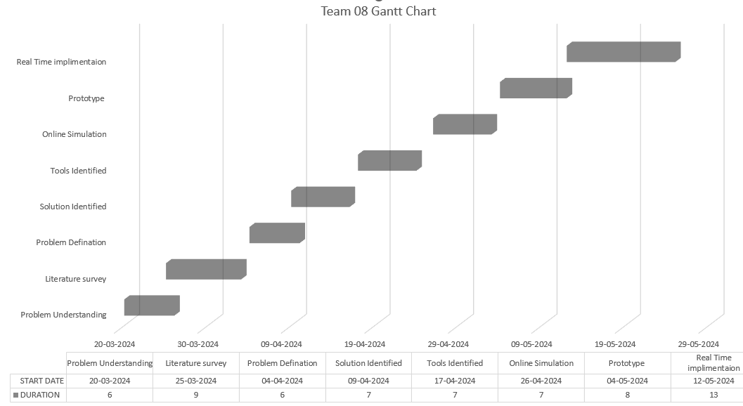
Project Planning (Gantt chart) and WBS (Work Breakdown Structure).

Slide 4
Project Planning (Gantt chart) and WBS (Work Breakdown Structure).
MEMBER | WORK
Shivananda Biradara | Simulation(Arduino (Proteus),Thinker cad),Literature survey, Prototype
Prabhodh Kulakarni | Simulation(Arduino (Proteus)),Literature Survey, Report writing, Prototype
Suresh Kini | Tools identification, Specifications, Existing technology, Literature Survey, Prototype
Soubhagya Bhovi | Tools identification, Specifications, Existing technology, Literature Survey, Prototype

Slide 5
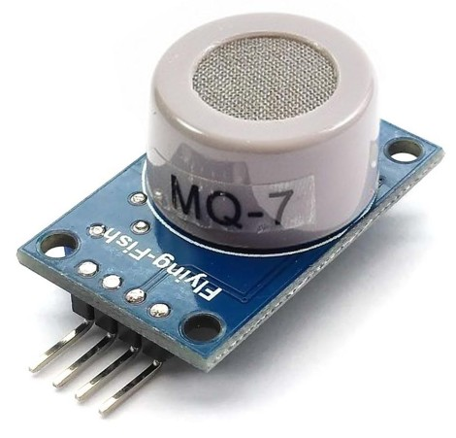
Specification and identification of input & output.
Target Gas: Carbon monoxide (CO).
Detection Range: 20 to 2000 parts per million (ppm).
Supply Voltage: 5V DC.
Operating Temperature: Ranges from -10 to +50 degrees Celsius.
Load Resistance: 10 kΩ for detecting the concentration range effectively.
Response Time: Less than 1 minute to achieve 90% of the final value when exposed to the target gas.
Recovery Time: less than 30 seconds to return to 90% of baseline.
Analog Output Voltage: The higher the CO concentration, the higher the voltage.
Sensitive Material : SnO2
MQ 7

Slide 6
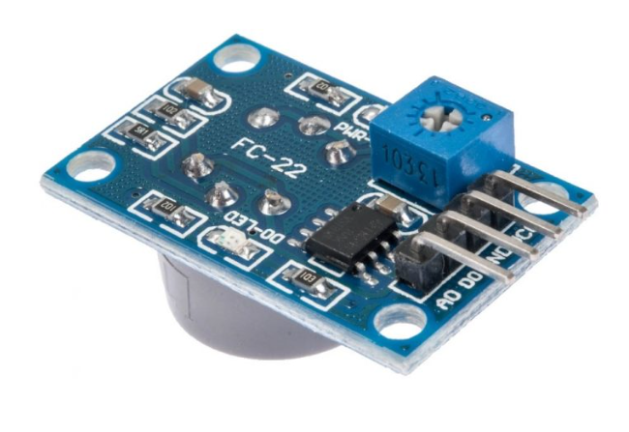
MQ 7
Power LED
Sensitivity Adjustment by potentiometer
VCC
GND
Digital Output
Analog Output
DOUT LED
LM393 Amplifier

Slide 7
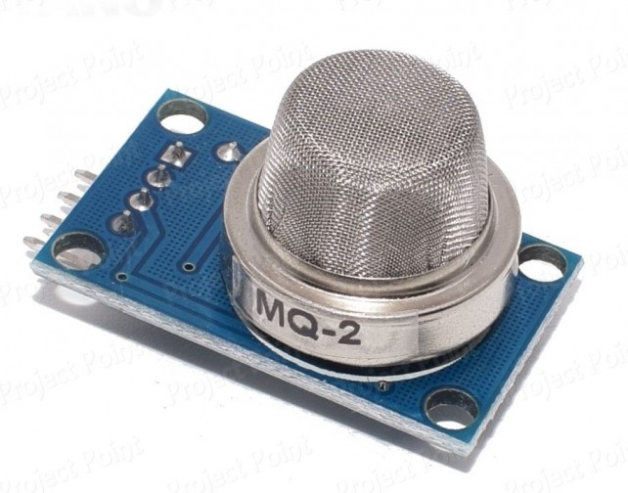
Specification and identification of input & output.
Target Gas : Hydro Carbons (HC).
Detection Range: 200 to 10000 ppm.
Operating Temperature Range: -10°C to 50°C.
Analog Output Voltage: Ranges from 0V to 5V.
Digital Output Voltage: Either 0V or 5V (TTL Logic).
Preheat Duration: 20 seconds.
Sensitivity: The sensitivity of the digital pin can be adjusted using the potentiometer.
Applications: It can be used for gas leakage detection in homes and industries. Suitable for detecting LPG, i-butane, propane, methane, alcohol, hydrogen and smoke.
MQ 2

Slide 8
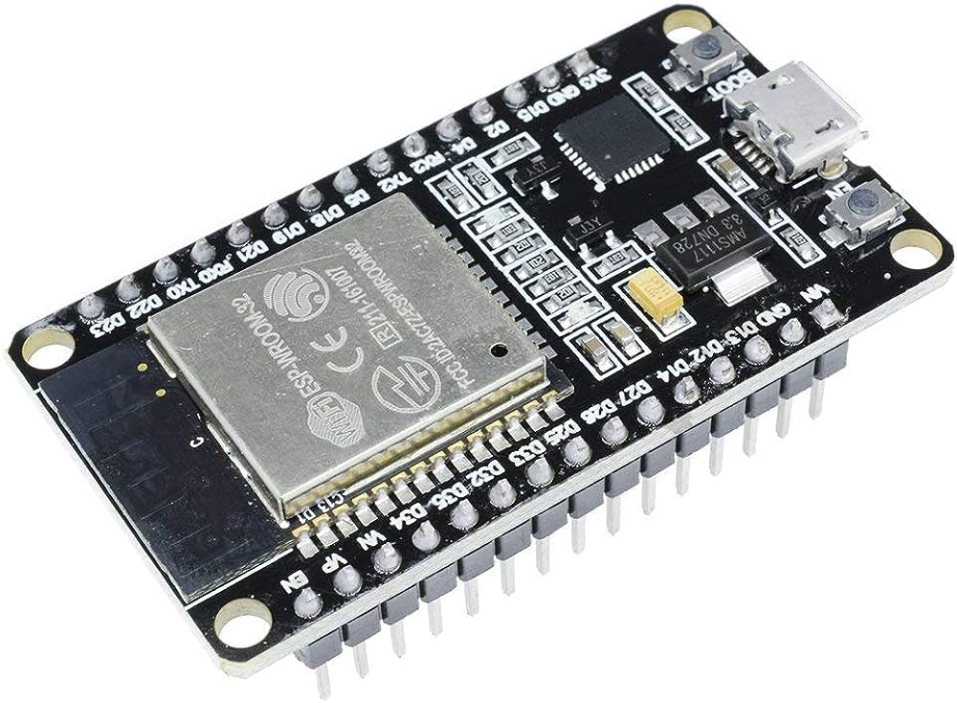
Specification and identification of input & output.
1. Microprocessor:
It features a single or dual-core 32-bit LX6 microprocessor with a clock frequency of up to 240 MHz.
The ESP32 has 520 KB of SRAM, 448 KB of ROM, and 16 KB of RTC SRAM.
2. Wireless Connectivity:
Wi-Fi: Supports 802.11 b/g/n Wi-Fi connectivity with speeds of up to 150 Mbps.
Bluetooth: Provides support for both Classic Bluetooth v4.2 and BLE (Bluetooth Low Energy) specifications.
3. GPIOs:
The ESP32 offers 34 programmable GPIOs, allowing you to interface with various sensors, actuators, and peripherals.
ESP 32
4. Analog and Digital Interfaces:
ADC: Up to 18 channels of 12-bit SAR ADC (Analog-to-Digital Converter).
DAC: 2 channels of 8-bit DAC (Digital-to-Analog Converter).

Slide 9
Specification and identification of input & output.
5. Integrated RF Components:
The ESP32 includes built-in components such as antenna switches, RF balun, power amplifier, and low-noise receive amplifier.
These integrated components simplify hardware design around the ESP32.
6. Manufacturing Technology :
The ESP32 is manufactured using TSMC’s ultra-low-power 40 nm technology.
This makes it suitable for battery-operated applications like wearables, audio equipment, and smartwatches.
ESP 32

Slide 10
Specification and identification of input & output.
Supply Voltage: 5V DC.
Hydro Carbons (HC).
Detection Range: 200 to 10000 ppm.
Operating Temperature Range: -10°C to 50°C.
Carbon monoxide (CO).
Detection Range: 20 to 2000 parts per million (ppm).
Operating Temperature Range: -10°C to 50°C.

Slide 11
Simulation of the design using any open source.
#include <LiquidCrystal.h>
// Pin definitions
const int mq2Pin = A0; // MQ2 sensor pin
const int mq7Pin = A1; // MQ7 sensor pin
float mq2Value ;
float mq7Value ;
// LCD module connections (RS, E, D4, D5, D6, D7)
LiquidCrystal lcd(12, 11, 4, 5, 6, 7);
void setup() {
// Initialize serial communication
Serial.begin(9600);
// Initialize the LCD
lcd.begin(16, 2);
}

Slide 12
Simulation of the design using any open source.
void loop() {
// Read sensor values
mq2Value = analogRead(mq2Pin);
mq7Value = analogRead(mq7Pin);
// Print sensor values to the Serial monitor
Serial.print("MQ2: ");
Serial.print(mq2Value);
Serial.print("\nMQ7: ");
Serial.println(mq7Value);
// Print sensor values on the LCD
lcd.clear();
lcd.setCursor(0, 0);
lcd.print("MQ2: ");
lcd.print(mq2Value);
lcd.setCursor(0, 1);
lcd.print("MQ7: ");
lcd.print(mq7Value);
delay(100);
}

Slide 13
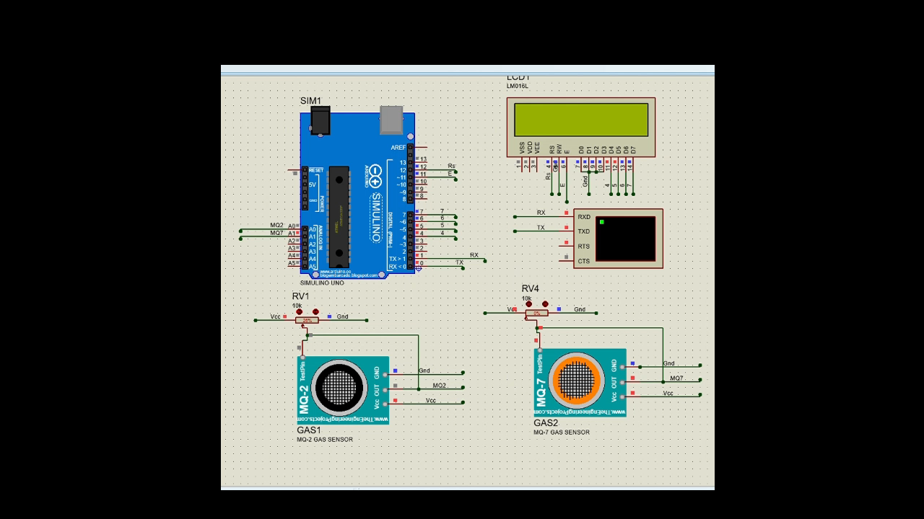
Simulation of the design using any open source.

Slide 14
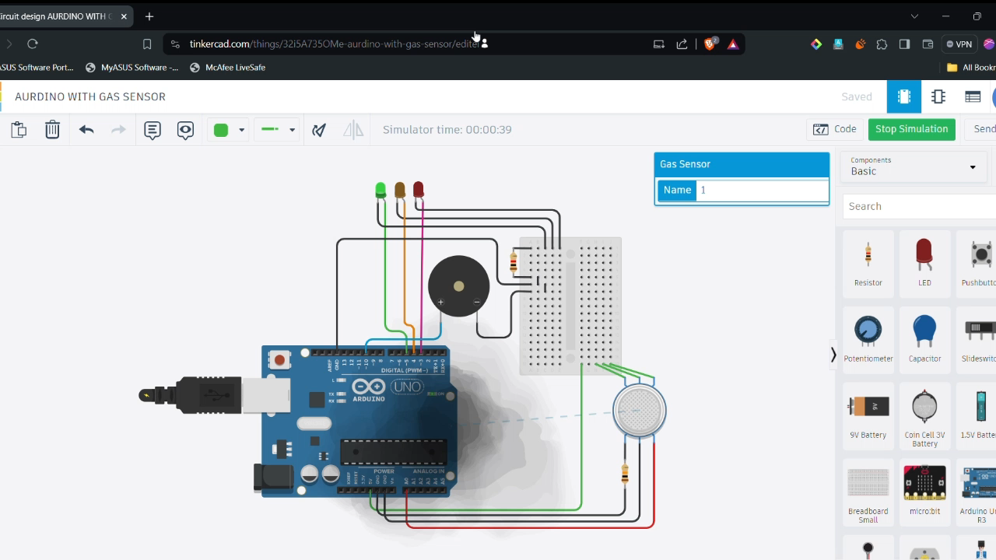
Simulation of the design using any open source.(Thinker Cad)

Slide 15
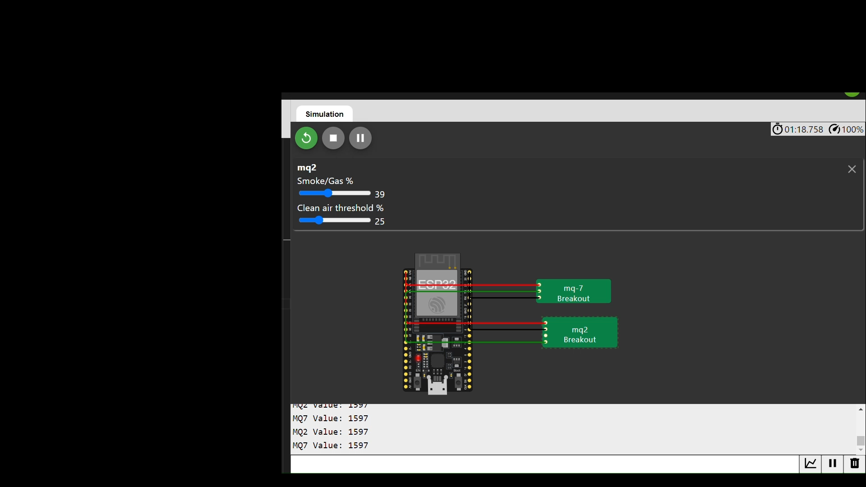
Simulation of the design using any open source.(WOKWI)

Slide 16
MINOR PROJECT 01​
TEAM M1-ADLD-08 ​
Develop a portable emission testing unit
TEAM DETAILS​
SL.NO | NAME | USN
01 | PRABHODH KULKARNI | 01FE21BEC049
02 | SURESH G KINI | 01FE21BEC255
03 | SHIVANANDA BIRADARA | 01FE21BEC272
04 | SOUBHAGYA A BHOVI | 01FE21BEC302
Under the guidance of: Shivashankar A Huddar

Slide 17
Compare analog and digital pins.
Analog Pin: It gives the voltage from 0v – 5v based on the concentration of the gas.
Digital Pin: It gives the Digital output as high or low based on the value set by the potentiometer
Sampling rate of ADC in ESP32.
It has a 12-bit ADC means it will give digital values in the range of 0 – 4096 (2^12).
2MHz : When Wi-Fi is disabled.
1KHz : When Wi-Fi is enabled.

Slide 18
Block Diagram
Firebase
CO and HC sensor unit
Gas content
readings
Microcontroller
Pass/Fail
Exhaust gas
Gas sensors
Adc
WiFi
Standard value
Web page
Report.
Document Generated

Slide 19
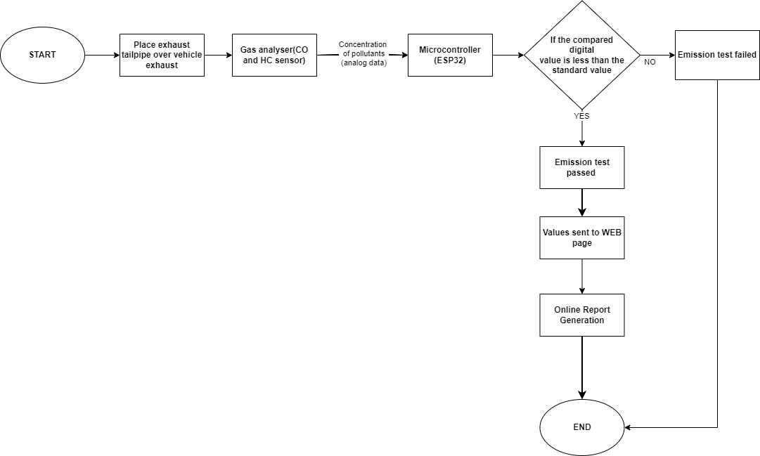
Flow Chart

Slide 20
Plan and need for Optimization
Project Plan
1. Initial Research and Specifications
Conduct a detailed literature survey on existing portable emission testing units.
Determine the specifications for the sensors (MQ-7 for CO and MQ-2 for HC).
Identify tools and technologies to be used.
2. Design and Simulation
Develop a prototype using simulation tools like Arduino (Proteus), Thinkercad, and Wokwi.
Create a detailed Work Breakdown Structure (WBS) and Gantt chart to manage tasks and timelines.
3. Hardware Selection and Assembly
Choose between existing sensors and designing new ones based on the project’s requirements.
Assemble the components, including the ESP32 microcontroller, sensors, and other peripherals.

Slide 21
Plan
4. Software Development
Write the code for sensor integration and processing.
Implement the control unit logic to manage sensor readings and output results.
5. Testing and Optimization
Conduct initial testing to validate the functionality of the prototype.
Optimize the design based on feedback and test results, focusing on improving sensor accuracy, response time, and power efficiency.
6. Final Integration and Validation
Integrate all components into a final working model.
Perform comprehensive testing to ensure the unit meets all specifications and requirements.
Prepare documentation and reports on the project outcomes.

Slide 22
Need for Optimization
1. Sensor Accuracy and Sensitivity
Ensure that the MQ-7 and MQ-2 sensors are calibrated correctly to provide accurate readings of CO and HC gases respectively.
Fine-tune the sensitivity using potentiometers and validate against known gas concentrations.
2. Power Management
Optimize the power consumption of the ESP32 and sensors to make the unit suitable for portable use.
Explore power-saving modes and efficient power supply designs to extend battery life.
3. Data Processing and Sampling Rate
Optimize the sampling rate of the ADC in the ESP32 to balance between accurate readings and power efficiency.
Compare the performance of analog and digital pins to determine the most reliable method.

Slide 23
4. Response and Recovery Time
Enhance the response time of the sensors to quickly detect changes in gas concentrations.
Reduce the recovery time to enable the unit to reset and be ready for new measurements rapidly.
5. User Interface and Usability
Develop a clear and intuitive interface for displaying sensor readings.
Ensure the unit is easy to operate, even for users without technical expertise.
6. Size and Portability
Optimize the physical design to make the unit compact and lightweight.
Ensure all components are securely mounted to withstand portable use.

Slide 24
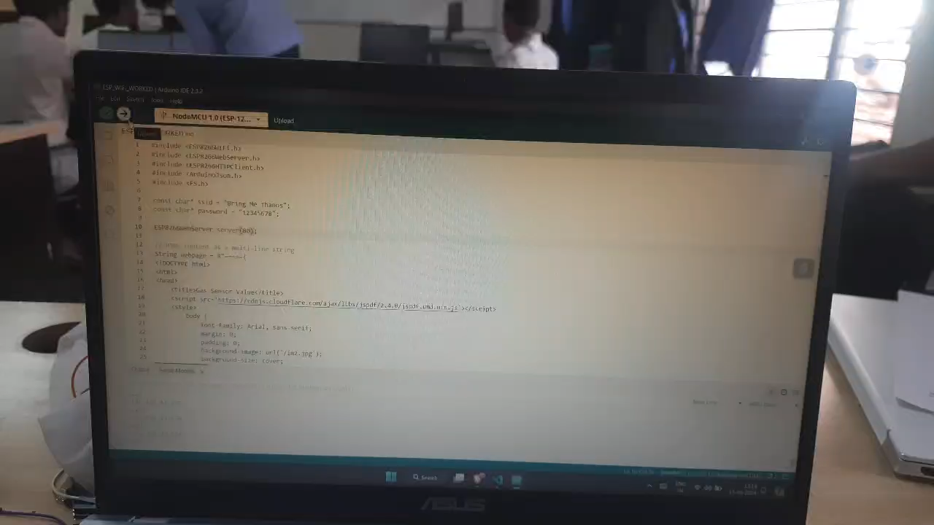

Slide 25
Relation to SDGs
Resilient Infrastructure:
Deployable in remote areas lacking traditional infrastructure.
Enhances understanding and management of environmental impacts.
Inclusive Industrialization:
Accessible to SMEs for monitoring and reducing emissions.
Promotes sustainable practices across industries.
Fostering Innovation:
Encourages technological advancements in emission testing.
Contributes to global environmental monitoring and mitigation efforts.

Slide 26
Power Consumption Analysis
Both MQ2 and MQ7 sensors operate at 5V DC and have a similar power consumption profile. Here are the typical power consumption details:
MQ2 Sensor Power Consumption:
Operating Voltage: 5V
Typical Heater Current: 150mA
Power Consumption: P=5V×150mA=0.75W
MQ7 Sensor Power Consumption:
Operating Voltage: 5V
Typical Heater Current: 150mA
Power Consumption: P=5V×150mA=0.75W

Slide 27
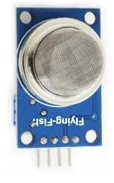
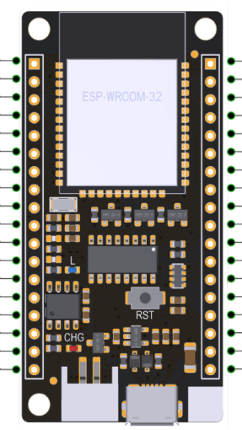
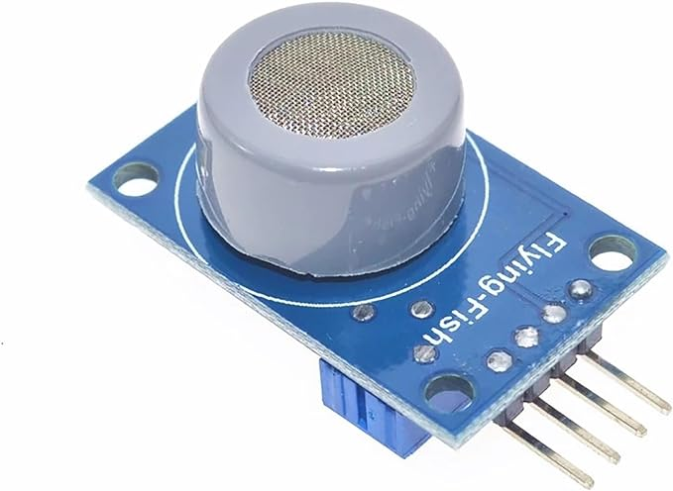
Different approach’s (Hardware) :
D1
D2

Slide 28
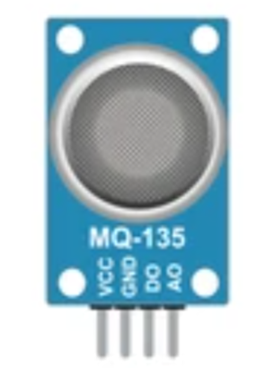
Different approach’s (Hardware) :

Slide 29
Different approach’s(Hardware) :
D1
Voltage
Doubler
D2
Voltage
Doubler

Slide 30
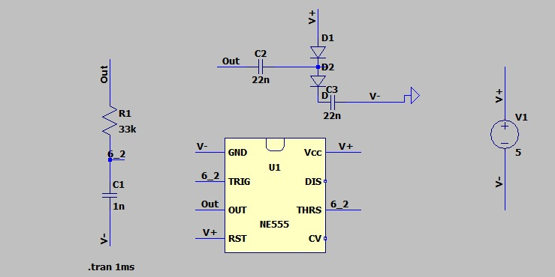
Voltage Doubler Circuit :

Slide 31
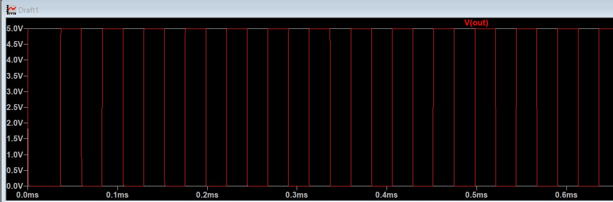
555 Timer Output:

Slide 32
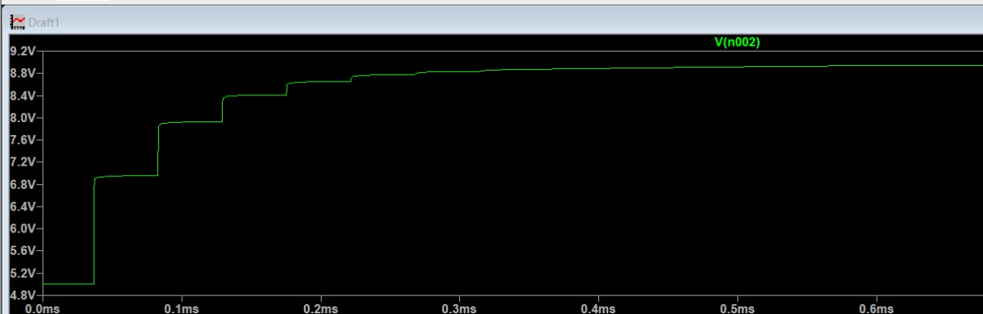
Voltage Doubler Output:

Slide 33
Software Approach.
Add Bluetooth
By addition of Bluetooth it will make easier for connectivity and almost every smartphone have the Bluetooth it will be very easier.
But lonely Bluetooth will not meet the objectives.
2. Add Wifi and Bluetooth
By addition of wifi along with the Bluetooth will make user friendly and anyone who will be in the network can access the websites through the wifi.
But for the real time we need to store it somewhere .

Slide 34
3. Add Firebase for datastorage
By adding firebase to the project will make model more efficient and as we can store the data and access the data world wide.
We can retrieve the previous data stored and analyze the current data with the previous data and find some problems for diagnosis.
Limitations.
When we integrate wifi and Bluetooth the memory is not sufficient for the program.We need to optimize the program.
After certain level of optimization also the code will exceed the memory.
So we need to trade-off between the Bluetooth and wifi.
So in this project we used the wifi.

Slide 35
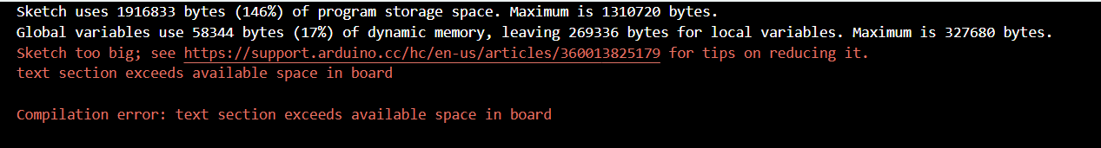
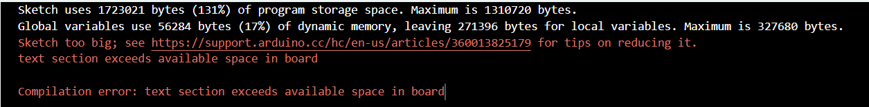
Optimizations
Wifi+Web+Bluetooth+Firebase
Before optimization
After optimization

Slide 36
WiFi + Firbase
Before
After
Optimizations made
Usage of light headers.
Usage of the pointers while sending the strings to the functions.
Removing Large strings.

Slide 37
Working Algorithm.
Connect to the Wi-Fi and Display the IP address.
Calibrate the sensors.
Start the Http server.
Display the readings on serial monitor.
Ask user whether store it on firebase or not.
If yes then ask the Numberplate number.
Then store it on firebase.
Look for the previous data and print it on the serial monitor.
Compare the results and Give summary of the readings.

Slide 38
THANK YOU

